Slide 1


Red Stopper
CACTUS
(Archana Singh, Gauri Rampal)

Slide 2
Our Agenda
01
02
03
Introduction
What do we need?
How this will help?
Notes:
https://pixabay.com/photos/grenade-rock-nikon-2380418/

Slide 3
Introduction
COVID -19
RISK
Currently the world is suffering from COVID-19 and because of this pandemic the entire business has come to a halt.
We don’t know anything about the people we are interacting with?.
COVID-19
RISK
ZONES
Availability
ZONES
BACK TO WORK
We have divided the cities into different zones
What are the challenges we have when go to work
GENPACT

Slide 4
SWOT Analysis
Strengths
W
We do not have to share any confidential data with any of the outside application. We do not have to save any data at our local
Weaknesses
We would need to get live data on regular intervals.
S
T
O
Threats
Opportunities
If the staff’s current address is not updated the application may not give a clear picture
It will be an opportunity for all the organizations/apartments to have a check on a regular basis what % of staff can be allowed at a time.
GENPACT

Slide 5

We Offer
Service 02
Can be integrated with an existing application used in Residential building like Adda, MyGate etc.
An application which can check if an employee from a Red zone is entering the premise
Red Stopper
Service 01
Service 03
Integrates with existing badging system of an organization
Can disable user’s entry for # of hours. Also will send alert to Employee and Organization
GENPACT

Slide 6
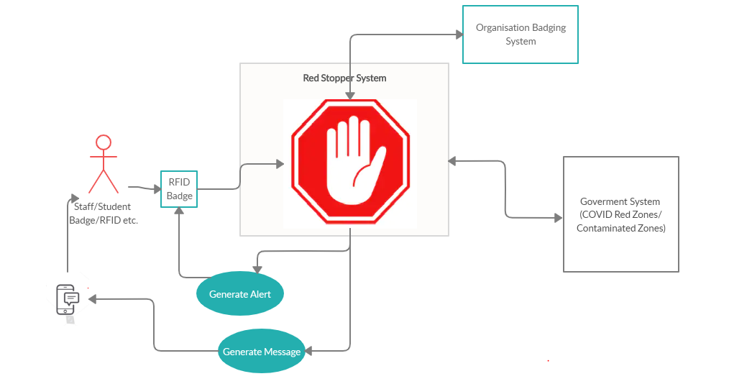

Slide 7
Technical Stack
Spring
No UI involved
No Database involved
Integration layer may change as per existing Badging System

Slide 8

Thank you

